Slide 1
4 rules of simple design
Quick intro

Slide 2

Concept from XP
Kent Beck was responsible for identifying these 4 rules, while building the principles of extreme programming

Slide 3
4 rules
Tests pass
Express intend
No duplication
Small

Slide 4
Tests pass
Should be able to prove that the system is working and tests are able to ensure just that

Slide 5
Expresses intend
The code should be easy to understand, it shouldn’t surprise you
- principle of least astonishment

Slide 6
No duplication
Conceptually you should not duplicate code
- principle known as don’t repeat yourself

Slide 7
Small
The code shouldn’t have pieces not needed and it should contain the least number of elements

Slide 8
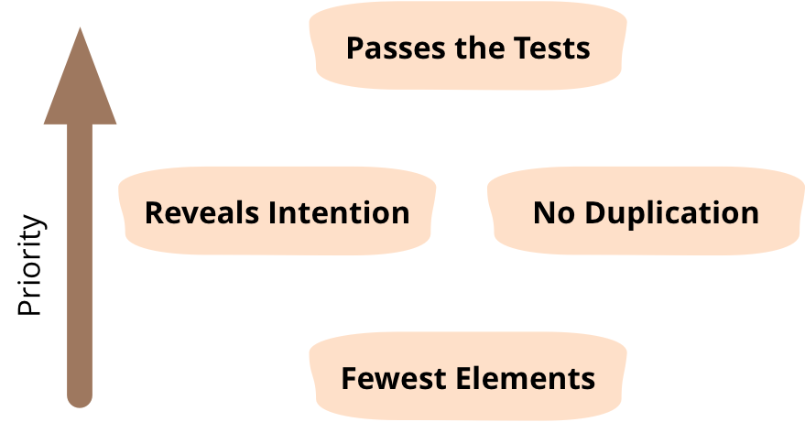
These are the priorities of the 4 rules

Slide 9
Let’s refactor a mini-app with these rules in mind!

